Slide 1
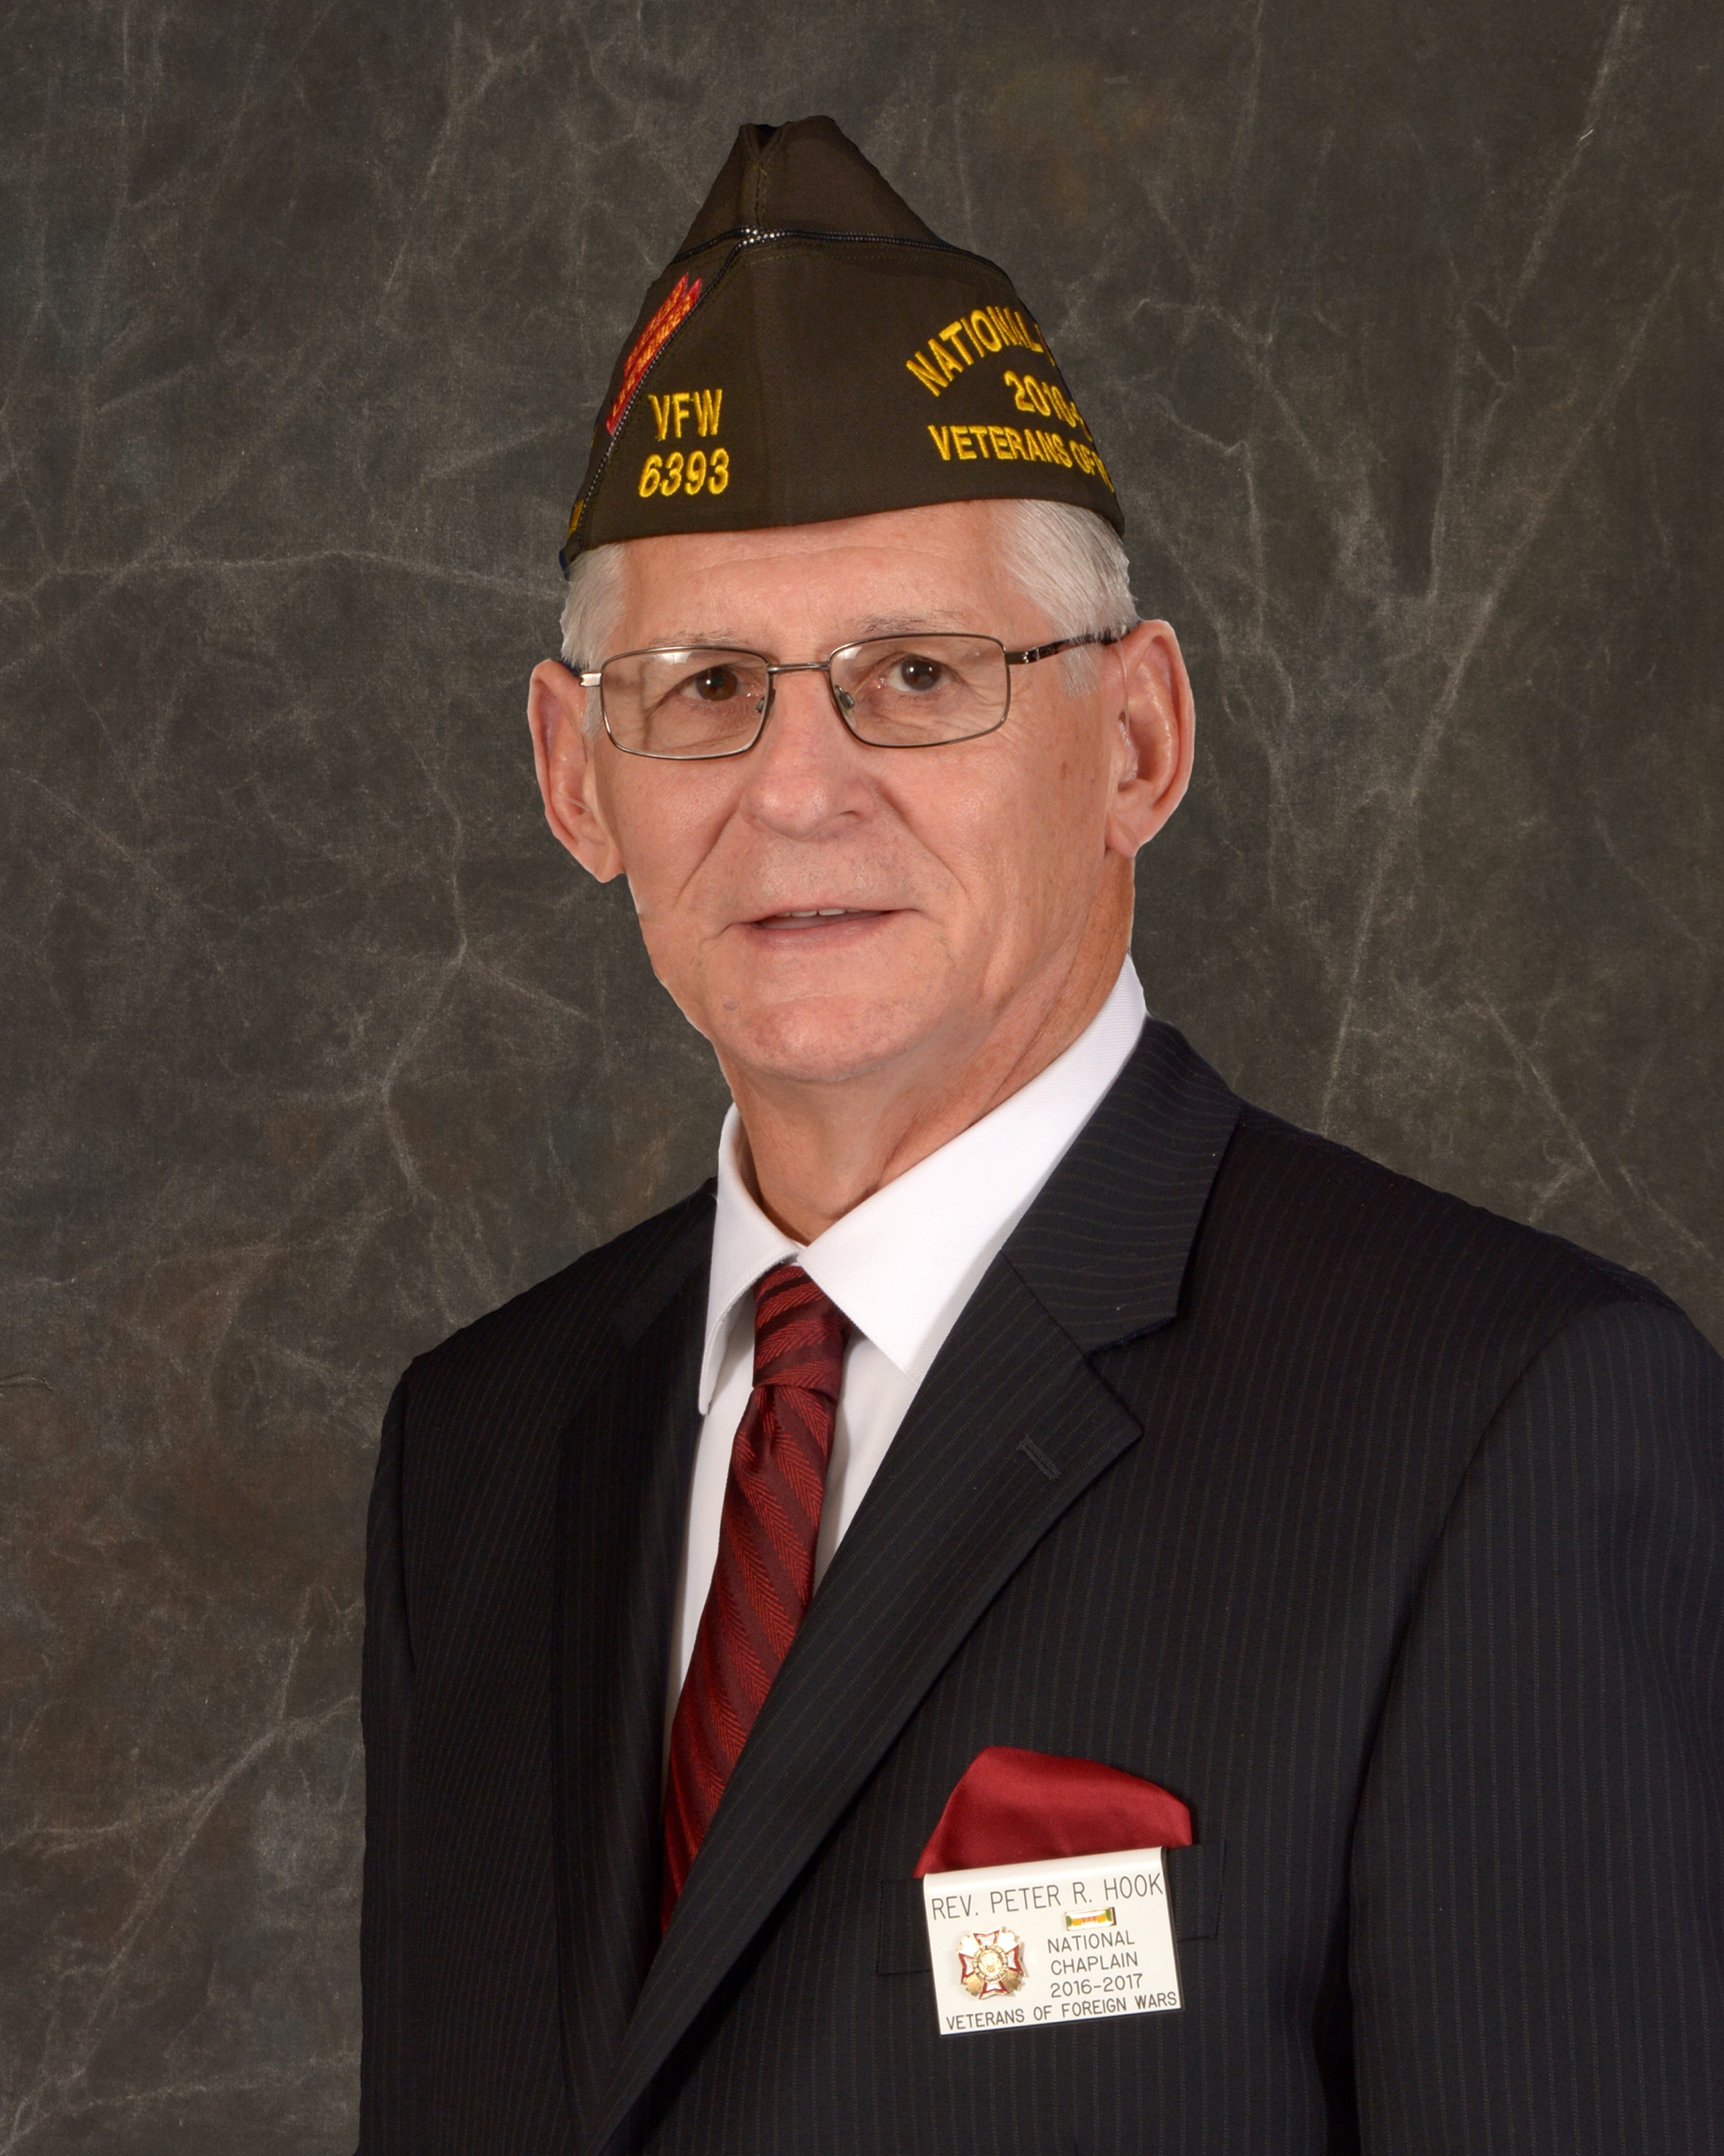
PA State Chaplain
Rev. Peter R. Hook
Chaplains Training
April 17, 2024

Slide 2
PA State Chaplain
Rev. Peter R. Hook
PeterHook@verizon.net
Cell: 267-229-7722

Slide 3
Organizational Structure
National Chaplain
Conference Chaplains
State Chaplains
District Chaplains
Post Chaplains

Slide 4
Four Conferences
Eastern
Big 10
Western
Southern

Slide 5
Memorial Services
At the beginning of each of our Post meetings we recite Section 230102 of the Congressional Charter. It is found on page 18 of the Ritual and states, “The purpose of this corporation shall be fraternal, patriotic, historical, charitable and educational; to preserve and strengthen comradeship among its members; to assist worthy comrades; to perpetuate the memory and history of our dead.” The VFW Ritual contains the Memorial Service on pages 74-79, and it seeks to fulfill that section of the purpose.
Eastern
Western
Southern

Slide 6
Memorial Services
The Memorial Service held each year at the National Convention, is a model set for each of us to follow. However, each department has freedom to add elements and make adjustments to the basic memorial service.
The key to making a memorial service meaningful and significant for those in attendance, is found in the execution of the details.
Eastern
Western
Southern

Slide 7
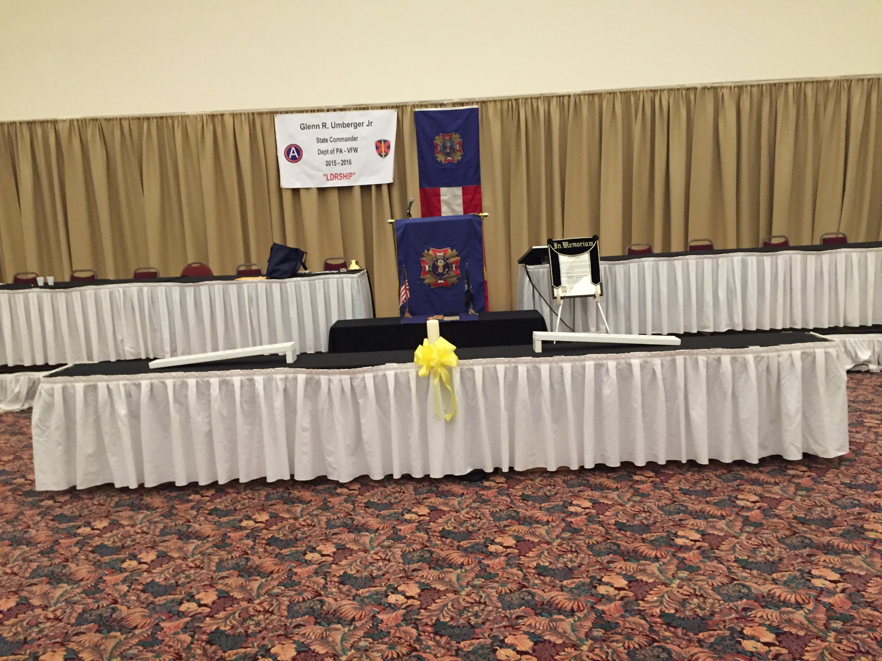

Slide 8
All who have a speaking part are seated on the platform on either side of the podium. At National they are on the platform seated in a row behind the podium.
In the picture there is one altar, and the Auxiliary charter is draped prior to the beginning of the service.

Slide 9
When the decision was made to have a unified memorial service using the VFW and Auxiliary, they decided to have two altars (one for the VFW and one for the Auxiliary). At the beginning of the memorial service the Auxiliary conducts a ceremony where they draped their charter and lay their Bible on their altar. (This is on page 3-4 of the National Script)

Slide 10
The VFW Auxiliary National Conductress and Color Bearers shall prepare the Auxiliary Altar with placement of the VFW Auxiliary Memorial Altar Cloth and Bible.
Instructions for setting the Altar
Color Bearers enter holding Memorial Altar Cloth, led by Color Bearers 3 and 4, followed by the Conductor/Conductress, who carries the open Bible. When in front of the VFW Altar, they very slowly lower the cloth onto the Auxiliary Altar. The Conductor/Conductress places the Bible on the Auxiliary Memorial Altar Cloth and steps back one (1) step.
Color Bearers 1 and 3 turn right, Color Bearers 2 and 4 turn left and proceed to the rear of the Altar, as Color Bearers 1 and 2 are in line with the Conductor/Conductress and retire.) The VFW Auxiliary National President returns to their seat.
NOTE: I feel this is too difficult and cumbersome to replicate once a year and I feel there should be only one altar. Therefore, I have the Auxiliary charter on an easel and draped prior to the start of the program. My auxiliary accepted this idea with no hassles.

Slide 11
Memorial Services
The Chaplain at the memorial service functions as a conductor of an orchestra. Those participating in the memorial service should be given a copy of the script ahead of time. That way they can prepare and become familiar with their part. When a person is prepared, and the presentation is done well, the speaker has poise and there is smoothness and a seamless flow that emanates from the person that makes the delivery seem so natural.
Eastern
Western
Southern

Slide 12
Memorial Services
Dress: VFW Blues & Grey with Commanders Tie and Cover. Auxiliary designates their Uniform.
Microphone is set and no one should adjust the microphone when they arrive at the podium.
If someone needs glasses to read the script, the glasses should be on prior to arriving at podium.
There is a podium script, and no one turns the pages except the chaplain. (There is one time at the beginning where the Commander will turn a page).
All participants who have a speaking part will be seated at the tables on the platform next to the podium.
Eastern
Western
Southern

Slide 13
Hook’s perspective and attention to detail
When a wedding is conducted, the eyes of the audience should be focused on the bride. Any unusual movement by those in the wedding party will draw the attention of the audience away from the bride to the person making the movement. When that happens it takes away from the primary focus and what is taking place between the bride and the groom.
It should never happen!
Eastern
Western
Southern

Slide 14
Hook’s perspective and attention to detail
There should be no water bottles and drinking of water, or looking at papers or one’s phone, or talking amongst those seated at the tables.
The participants seated at the tables must realize that any unusual movement by them will draw the attention of the audience to them.
Again, it should never happen.
Eastern
Western
Southern

Slide 15
Hook’s perspective and attention to detail
The participants seated at the tables on the platform must be careful not to make any unusual movement.
The focus of the audience must remain on what is being said and taking place as the service unfolds.
Eastern
Western
Southern

Slide 16
Various VFW Memorial Services
In the email I sent, I gave a list of the various VFW Memorial Services that are held with a copy of the script used for each.
Eastern
Western
Southern

Slide 17
Various VFW Memorial Services
National Memorial Service Script: (see attachment)
Eastern Conference Memorial Service Script and Bulletin: (see attachments) Note: Not every conference holds a memorial service.
Department of PA Memorial Service Script and Bulletin: (see attachments)
PA District 8 Memorial Service Script: (see attachment) Note: Not every district holds a memorial service.
Post 6076 Memorial Service Script: (see attachment) Note: Not every post holds a memorial service.
Eastern
Western
Southern

Slide 18
Memorial Service at Post Meeting
When my VFW Post has a death of a comrade, I will hold a brief memorial service for that comrade at the next post meeting.
The short memorial service takes place at the end of the meeting following the “Good of the Order.”
Here is an example of the format.
Eastern
Western
Southern

Slide 19
Memorial Service at Post Meeting
Following the Good of the Order, Commander will say, “Chaplain, lead us in a memorial service for our recently deceased comrade.”
Chaplain Reads portion of the Obituary
Freddie (Fred) Eugene Ruppenthal (Lt. Col, Retired), age 88, passed away peacefully in Tucson, AZ, on April 1, 2023. A 1952 graduate of the former Myerstown High School, Fred married his high school sweetheart, Shirley (Ranaldi) Ruppenthal on October 17, 1955. On that same day, Fred was commissioned as a 2nd Lieutenant in the U.S. Air Force and received his Pilot Wings. Fred had a long career in the Air Force. He flew KC-97 refueling planes, served active duty in the Vietnam War, and in the 1970s served as a U.S. Liaison in Seoul, South Korea. Fred was also a test engineer for the development of the first U.S. military drones. Upon retiring from the Air Force, he moved back to Myerstown to spend time with his extended family. Fred was a lifetime member of the American Legion and was active in the Eastern Lebanon County Lions Clubs and the VFW. Fred, along with his wife Shirley, will be buried at the Indiantown Gap National Cemetery in Annville, PA; the date to be determined.
Eastern
Western
Southern

Slide 20
Memorial Service at Post Meeting
Following the reading of the Obituary:
If you are able, please rise. Chaplain offers a short prayer on behalf of deceased followed by the Draping of Charter Ceremony and the Playing of Taps.
Commander: There being no further business, we will have our closing ceremony.
Eastern
Western
Southern

Slide 21
PA State Chaplain
Rev. Peter R. Hook
Responses and Question

Slide 22
PA State Chaplain
Rev. Peter R. Hook
Blessings as You Serve

